Slide 1


DATA SCIENCE
UNIT 1- Introduction to Data Science
Presented by:
Sachin Saxena
SME, upGrade

Slide 2
1.4 Descriptive Statistics
Definition of Value, Standard deviation, Mean, median, mode with examples
Probability Theory
Definition of Probability with example
Definition and examples of Random event, mutually exclusive events, mutually independent events.
Definition and examples of Conditional Probability
Definition, examples and explanation of Probability density function
Explanation of Probability Distribution
Explanation, examples of Normal Distribution with graph
Explanation, examples of Binomial Distribution with graph
Explanation, examples, equation of Poisson Distribution with graph
Explanation of Bayesian Statistics
Explanation of Bayes Theorem with equation m) Bayesian Statistical method n) Example of Bayesian Statistics- Helmenstine’s (2017) drug test analysis

Slide 3
1.4 Descriptive Statistics
For each variable of a given dataset, probability theory determines a set of statistical parameters which report the dataset characteristics as a whole batch. Descriptive anal- ysis is then performed to provide end users with an understandable description of a specific dataset’s characteristics in various forms. Several statistical parameters are cal- culated to describe the variable clearly (Skiena, 2017). These statistical parameters include a variable’s minimum and maximum values, mean, median, and standard devi- ation.

Slide 4
1.4 Descriptive Statistics

Slide 5
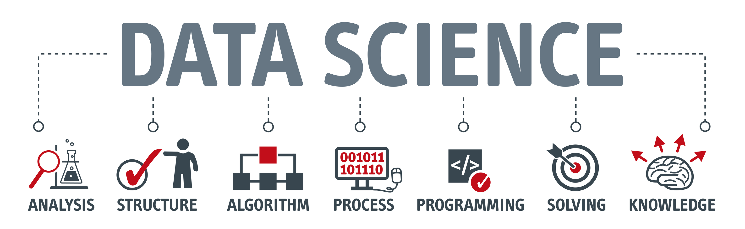
Definition of Value:
Value: Data's value (often called its usage value) refers to the application they are used for and the frequency of their use.

Slide 6
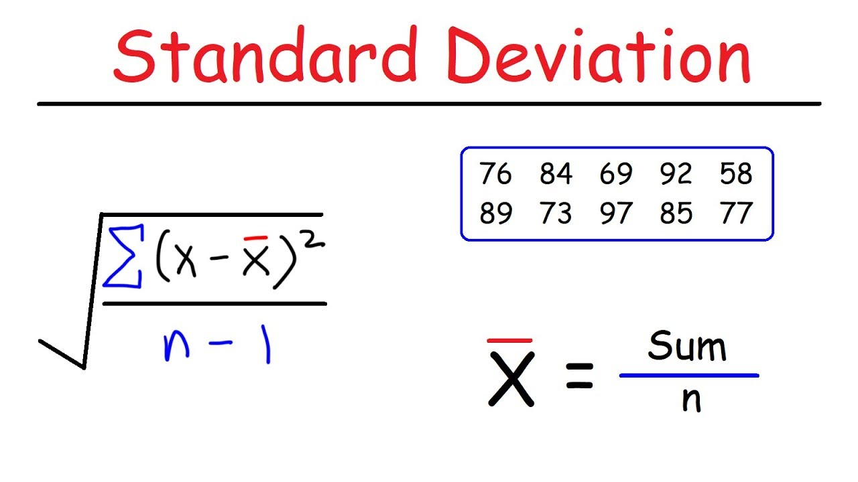
Standard deviation:
Standard deviation This is a measure for how spread apart data values are. It is typically applied for normally-distributed data.

Slide 7
Mean:
The mean is the arithmetic average of the variable’s values, while the median is the value located exactly at the middle point of a variable’s sorted values. The mean is more sensitive to extreme values than the median. For example, if the variable’s values are (2, 3, 4, 5, 6, 7, and 9), then:
Mean = 2 + 3 + 4 + 5 + 6 + 7 + 9/7 = 5 . 14
Median = 5

Slide 8
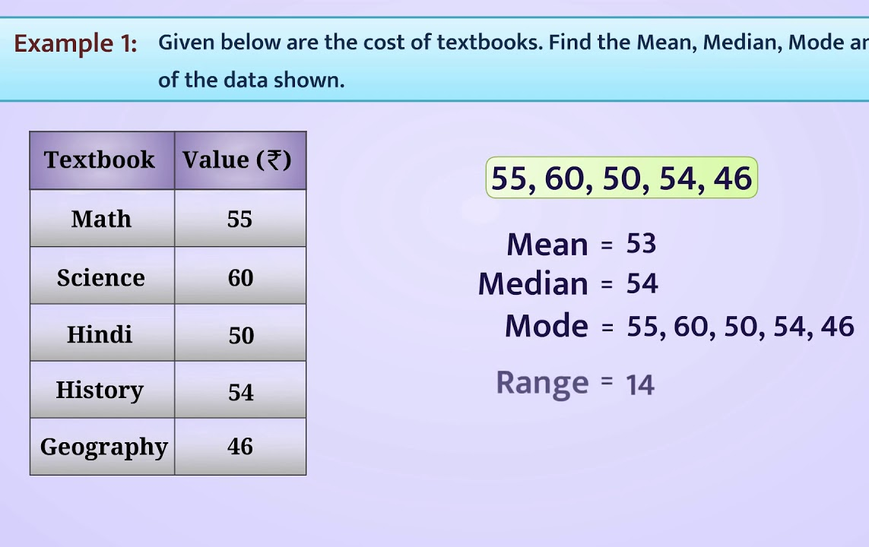
Mean, median,
mode with examples

Slide 9
Probability Theory:
Probability (P): The chance of an event happening is its probability (P).
Many important techniques in data science are based on probability theory. If an event is unlikely to happen, its probability is “P = 0”; if an event is certain to happen, its probability is “P = 1”. The probability of a random event is always between “0” and “1”, depending on the chance of its occurrence. The probability cannot be a negative value, and the sum of all probabilities must always be “1”.

Slide 10

Probability Theory

Slide 11
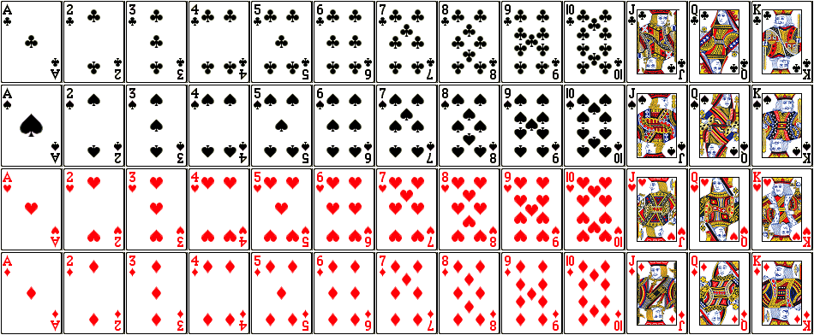
Probability Theory

Slide 12

Definition and examples of
Random event

Slide 13
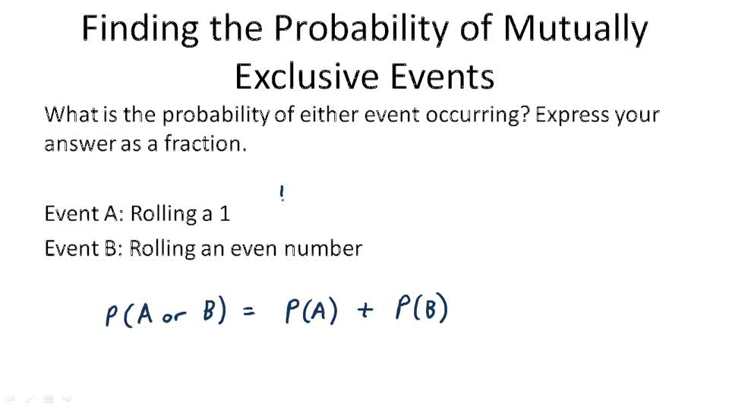
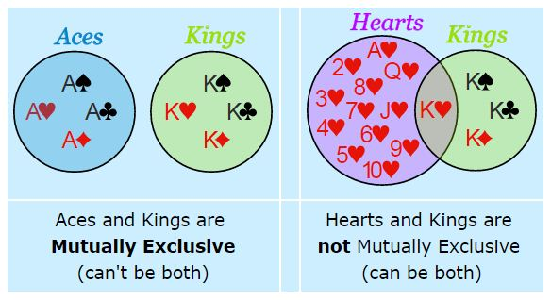
mutually exclusive events

Slide 14
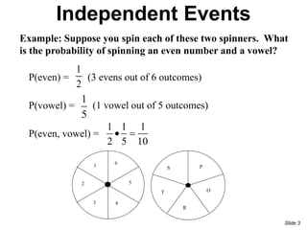
mutually independent events:

Slide 15
Definition mutually exclusive events:
If we are making profit (Event M) through one client account, we cannot make a loss (Event N) through that same account. In this case, a particular event (loss) cannot occur at the same time as another event (profit). These two opposite events are known as mutually exclusive events.
P( M and N ) = P (M ∩ N ) = 0
P ( M or N ) = P ( M ∪ N ) = P( M ) + P ( N )

Slide 16
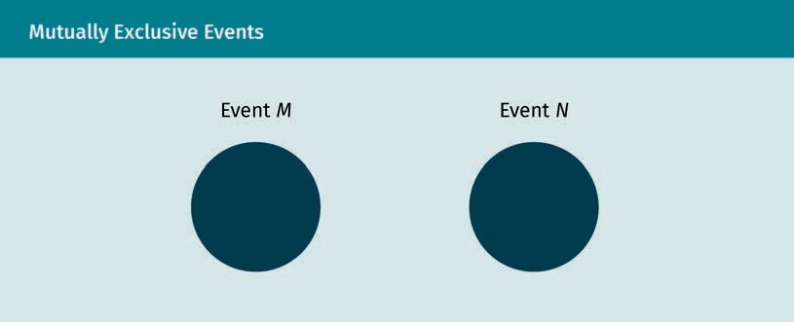
Definition mutually exclusive events:

Slide 17
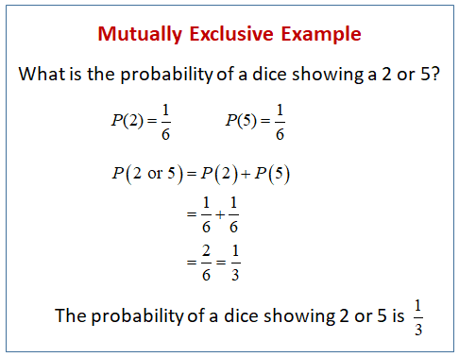
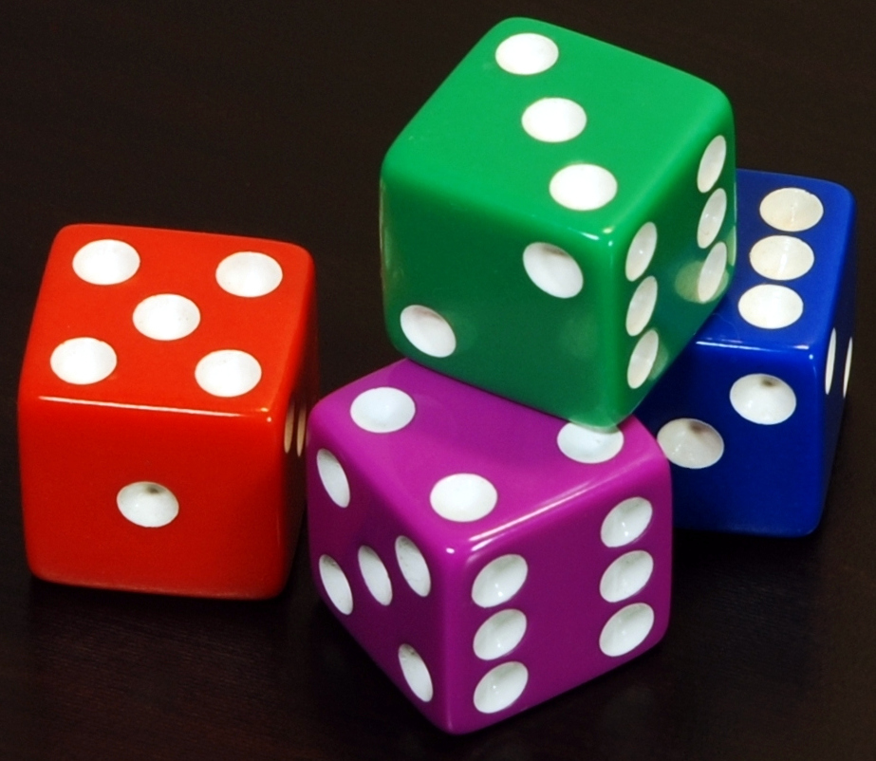
Definition mutually exclusive events:

Slide 18
Definition mutually independent events:
In another case, a company may be making a profit (Event A) but at the same time hav- ing legal issues (Event B). Both events can occur simultaneously and do not impact one another. They are said to be mutually independent events.
P (A and B) = P (A ∩ B) = P (A) · P (B)
P (A or B) = P (A ∪ B) = P (A) + P (B) − P (A ∩ B)

Slide 19
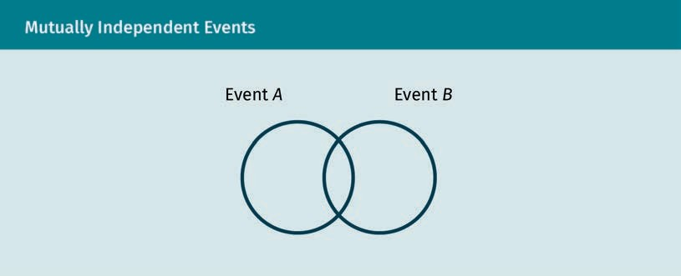
Definition mutually independent events:

Slide 20
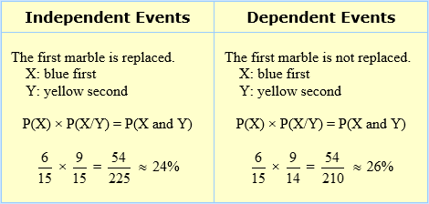


Definition mutually
independent events:

Slide 21
Definition and examples of Conditional Probability:
When two events are correlated, the conditional probability P AB is defined as the probability of an event A, given that event B has already occurred.
P (A*B) = P (A ∩ B )/P (B)

Slide 22
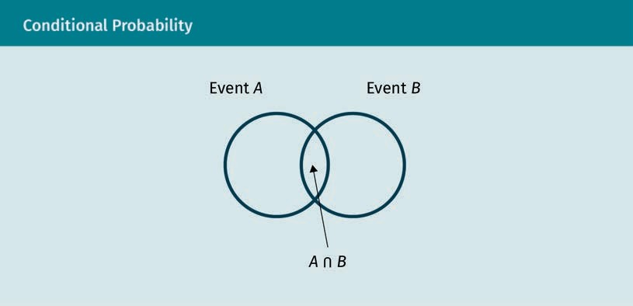
Definition and examples of Conditional Probability

Slide 23
Definition and examples of Conditional Probability:
In data science, all predictions from developed models are probabilities, having either a probability between 0 and 1 (for classification models) or a probability density distribution (for regression models). Operationally, model predictions need to be presented as one number which will be used by management to determine future actions and decisions.

Slide 24
Definition, examples and explanation of Probability density function:
In probability theory, a given value for a particular variable is considered a random event, and we calculate its probability of occurrence (i.e., how often this value appears within the variable’s values). We consider each variable's value a random event and then calculate its probability. This forms the probability density function (pdf).

Slide 25
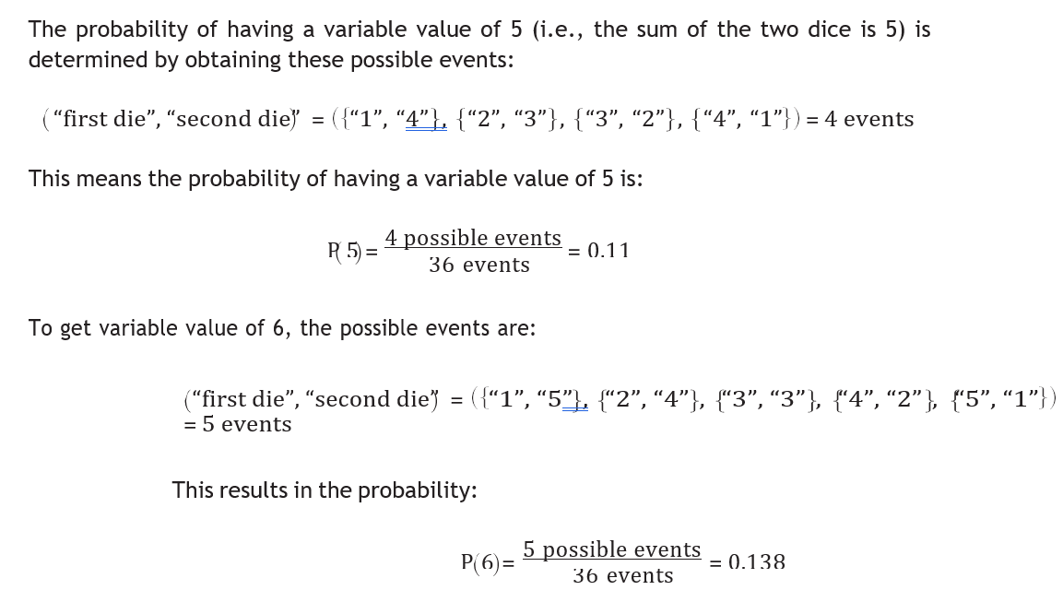
Probability
density function

Slide 26
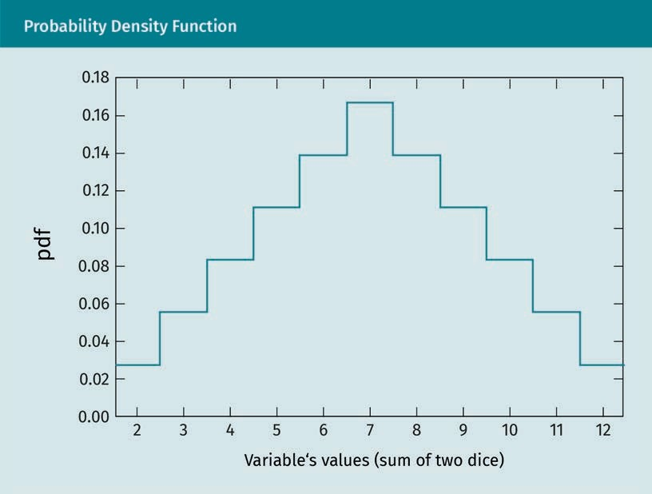
Probability density function

Slide 27
Explanation of Probability Distribution:
Every variable of a dataset meets a particular frequency distribution (i.e., definite prob- ability density function) which reflects how often each value of this specific variable occurs. Although the shapes of these frequency distributions are not unique, there are some general and classical distributions which regularly appear for a wide range of datasets. A pleasant property of these distributions is that they can be mathematically described with closed form expressions of a few parameters. The most important prob- ability distributions are reviewed in this section.

Slide 28
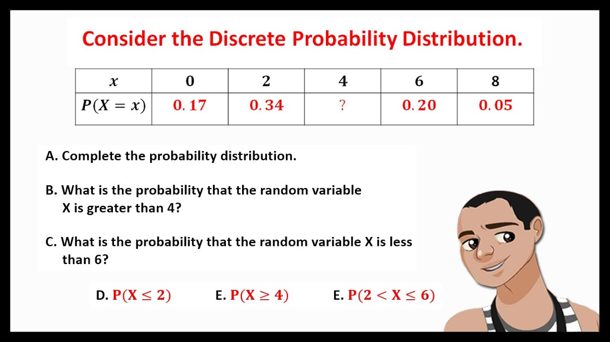
Explanation
of Probability
Distribution

Slide 29
Normal Distribution with graph:
The normal distribution has a bell-curve shape and represents a significant amount of real-life data attributes, because most attribute values center on their mean value. An example of normal distribution is the distribution of employee performance in an organization, where only a few employees are identified as high or low performers; most employees perform somewhere in the middle (i.e., in close proximity to the mean).

Slide 30
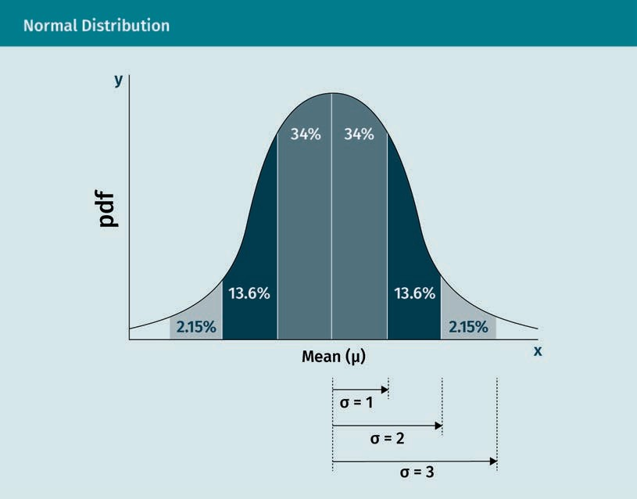
Normal Distribution with graph:
The normal distribution has 68% of values within standard deviation σ = ± 1; 95% of values within standard deviation σ = ± 2; and 99.7% of the values within standard deviation σ = ± 3.

Slide 31
Binomial Distribution with graph:
The binomial distribution monitors the success of an event occurring. An example of binomial distribution is a coin toss in which you win if “heads” is the outcome and lose if the outcome is “tails.” If you toss the coin twice, what is the probability of having “heads” only once? What is the probability of having two “heads”? And what is the probability of not having “heads” at all? The table below presents all the possible out- comes when the coin is tossed twice.

Slide 32
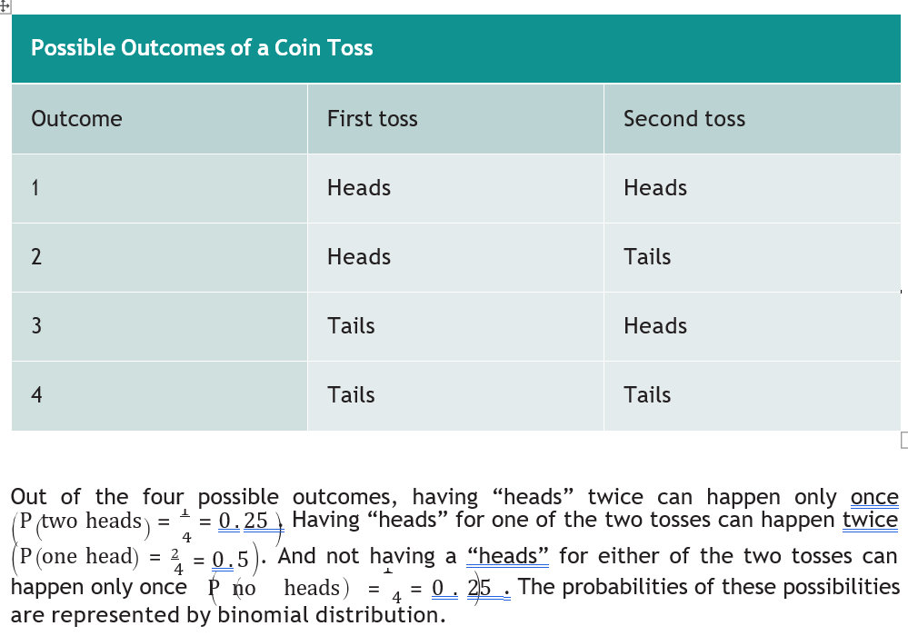
Binomial Distribution

Slide 33
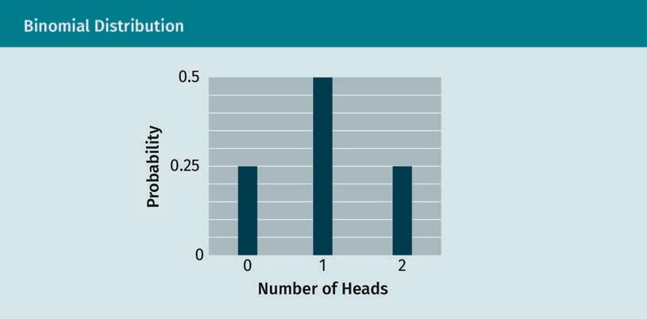
Binomial Distribution with graph:

Slide 34
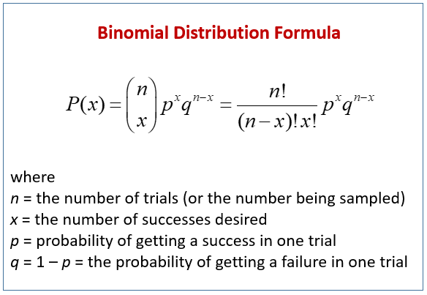
Binomial Distribution
with graph

Slide 35
Poisson Distribution with graph:
The Poisson distribution monitors the frequency of intervals between independent events. It calculates the probability of a certain number of event occurrences based on the mean number of occurrences. Mathematically, the Poisson distribution is represented by the following equation:

Slide 36

Central Limit Theorem:
Facebook Introduces Fact-Checking Alert for Fake News | Fortune

Slide 37
Central Limit Theorem:
Sampling Distributions (onlinestatbook.com)

Slide 38
1.1 Overview of Data Science
Define data with examples.
Define Information with examples.
Concept of Data Science
Usage of Data Science
Main drivers of data science
Distinct capabilities of Data Science (Baldassarre, 2016)
Definition of Data Mining
Venn Diagram for Data Science
Concept and aim of Business Intelligence
Definition of Common terms in Data Science with examples– Artificial Intelligence, Machine learning, Training and testing sets, Data variables, Types of errors
Types of Machine learning
Definition and objective of Dimensionality reduction.
Explanation of sensitivity and specificity
Applications of Data Science with examples

Slide 39
Overview of Data Science
Define data:
Data: These are facts, observations, assumptions, or incidences.
Data science The field of data science concerns the systematic practice of analyzing data, exploring the information contained in the data, and creating useful predictions to advise and guide the decision making process.

Slide 40

A further example of strategic use of data science tools is the Internet Movie Database (IMDB). IMDB provides data about all elements of the movie industry online. Every actor who has played a role in a movie listed in IMDB’s database has their own entry on the website.

Slide 41
Define Information: IMDB is implementing a data science tool to extract relevant information and answer questions such as:
Which actors appeared in the highest-rated movies?
Which actors are predicted to play starring roles in the coming year?
Which movie is expected to be the highest-rated film this year?
How closely do viewer ratings of movies correlate to movie awards?
What is the average age difference between actors playing husband and wife in a movie? Has this age difference increased or decreased over the last ten years? What is the forecasting for this difference over the next few years?

Slide 42
Information: Patterns and relationships among data elements are instances of information.
These data can be analyzed to get meaningful information, e.g., the total number of milk bottles sold, or which brand(s) sold most rapidly. Hence, the supermarket’s manager can have a deep understanding of all the parameters of the supermarket’s operations (replenishment, promotion planning, etc.) and transactions, estimate the hidden variables which control the processes, and predict what the supermarket can expect over the coming days and weeks. This type of analysis—which leads to the extraction of useful and/or hidden information, actionable insights, and reasonably accurate predictions—is an important aspect of data science.

Slide 43
Concept of Data Science:
Data in all forms (e.g., numbers, words, statistics, and measurements) are important units for businesses. With advances in computing resources and associated technologies, large amounts of data are generated and collected every day by different entities.
Examples abound, including monetary transactions through a financial institution, pat- terns of seismic activity in a region (sensor-generated data), and internet surfing history.

Slide 44
Concept of Data Science:
Data science is concerned with the arrangement, analysis, visualization, and interpretation of collected data for the purpose of extracting embedded knowledge and useful information and predicting scenarios should new or different data be introduced.

Slide 45
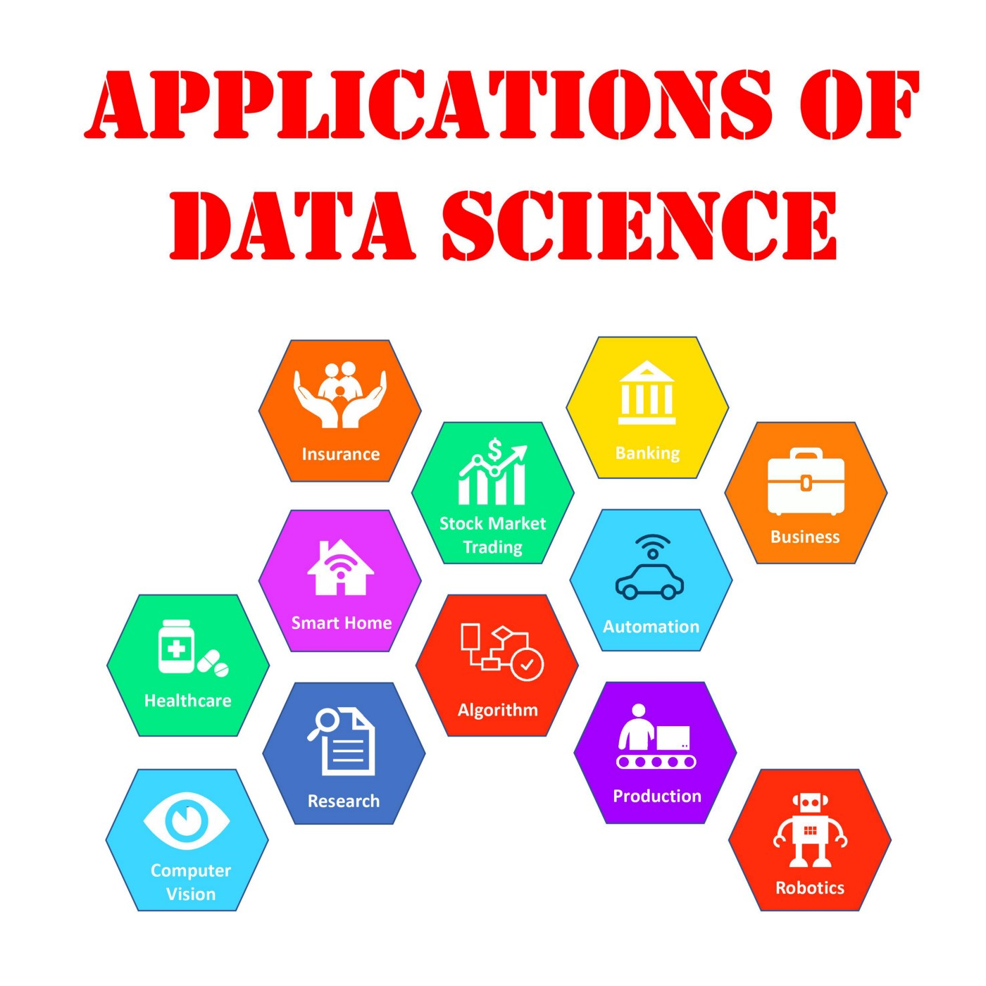
Usage of Data Science:
As a result, the output provided by applying data science can aid decision-makers in choosing appropriate actions, reviewing applicable thoughts, and thinking about optimum scenarios for their businesses. In some cases, applying data science may lead to automation of the entire business process, reducing the need for human intervention.

Slide 46
Main drivers of data science :
The main drivers of the emerging need for data science are
advances in computer capabilities and computing platforms;
availability of data from various sources; and
ability to store large amounts of data.

Slide 47
Distinct capabilities of Data Science (Baldassarre, 2016) :
Data science is an intrinsically data-driven and cross-/interdisciplinary field comprising many distinct overlapping capabilities. According to Baldassarre (2016), these capabilities include
• artificial intelligence (machine learning approaches in particular);
• data mining;
• pattern recognition;
• knowledge discovery (KDD);
• database storage and data processing;

Slide 48
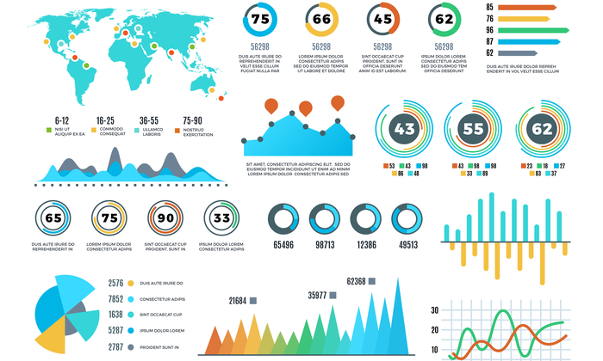
Distinct capabilities of DSata Science (Baldassarre, 2016)
• data visualization;
• statistics; and
• neurocomputing.

Slide 49
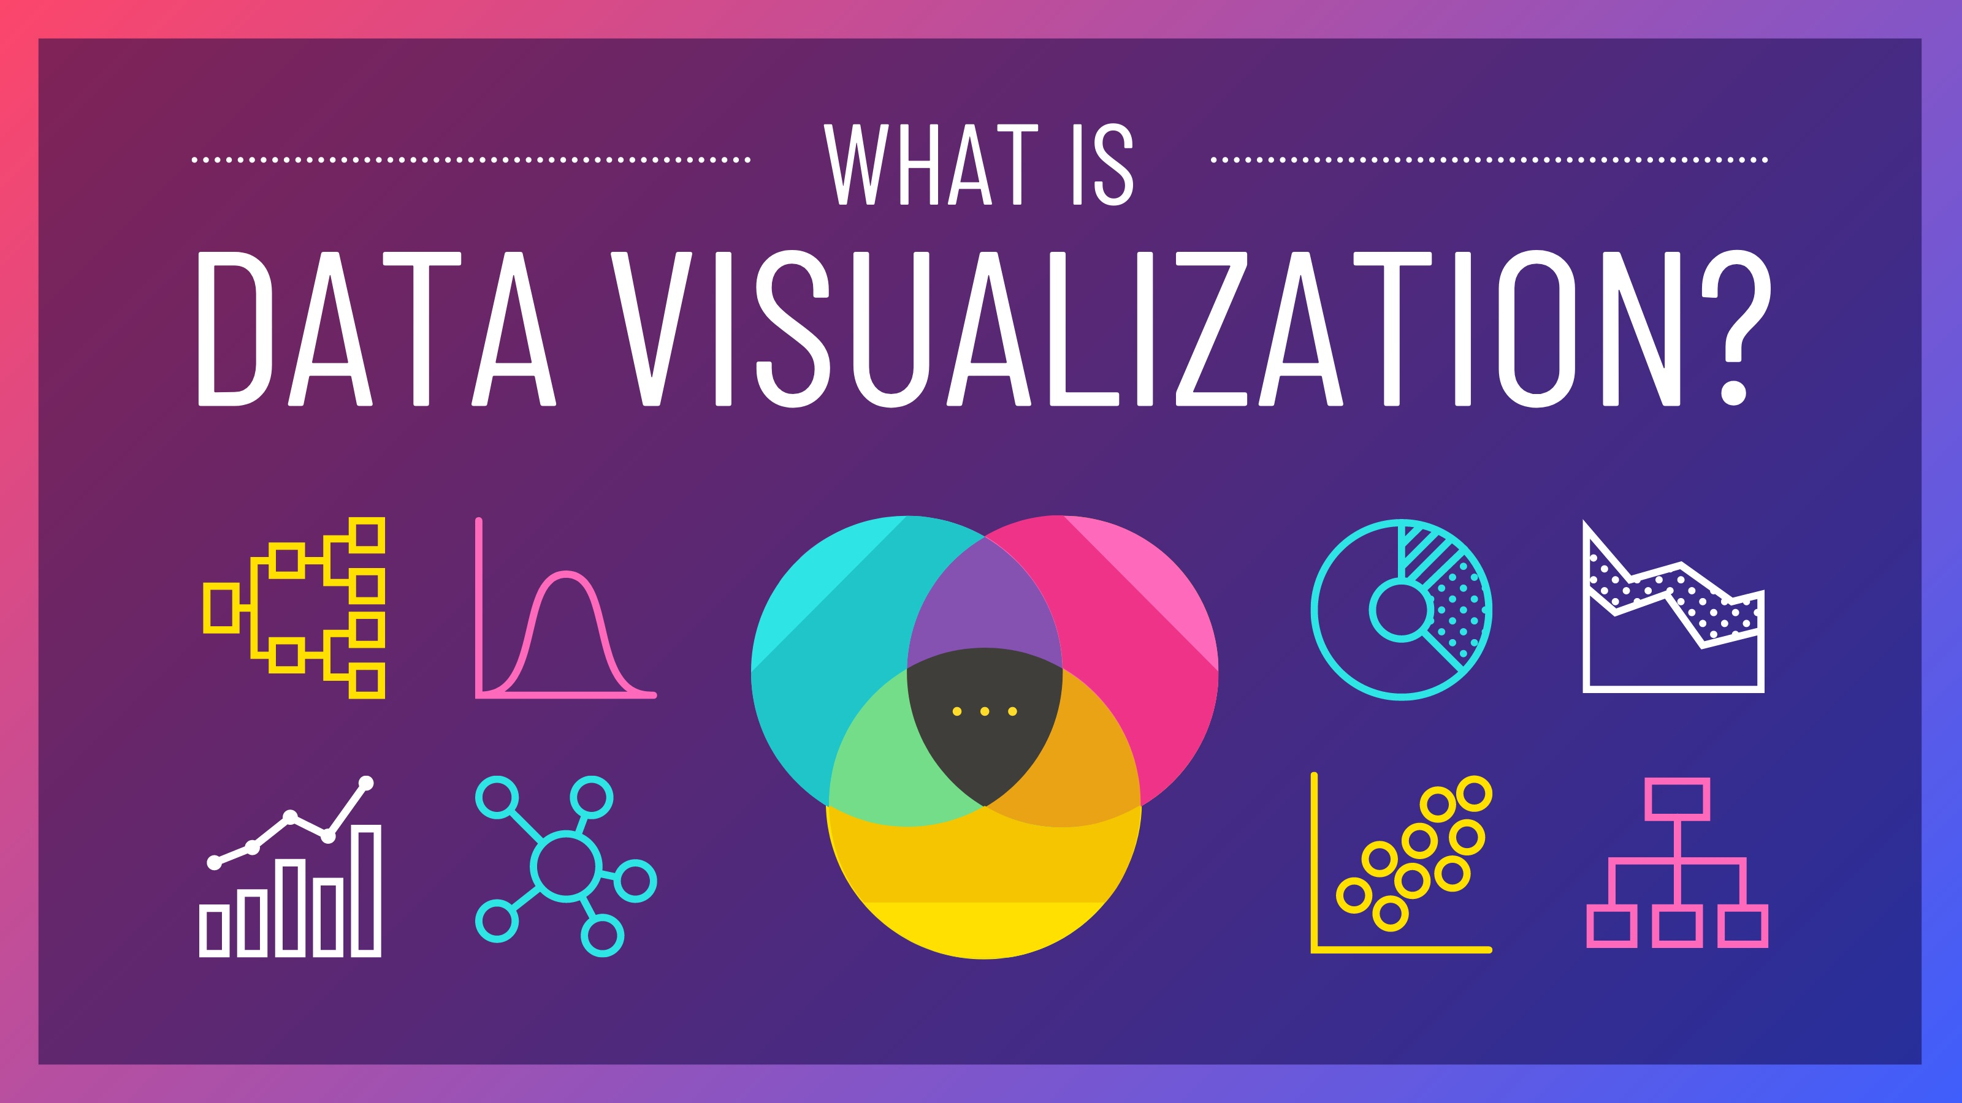
Distinct capabilities of Data Science (Baldassarre, 201
•These capabilities cooperate to create platforms for generating and sharing data, apply numerical techniques to organize and model data, and extract useful information from collected data, as illustrated by the data science Venn diagram.

Slide 50
Definition of Data Mining
Data mining This is the process of discovering patterns in large datasets.

Slide 51
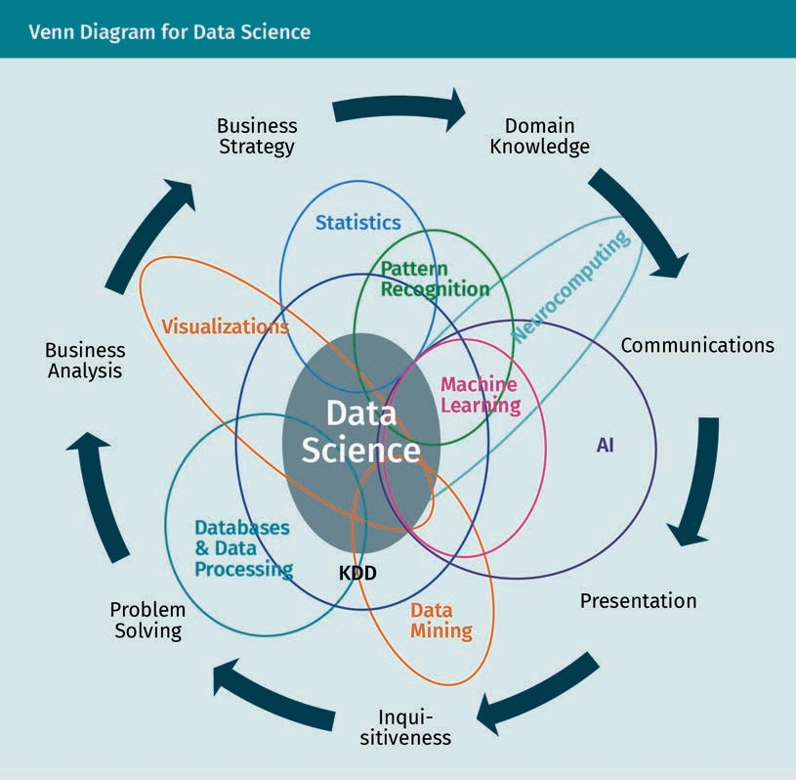
Venn Diagram for Data Science
Business intelligence This is a set of strategies for identifying, extracting, analyzing, managing, and delivering important trends relevant to business metrics.

Slide 52
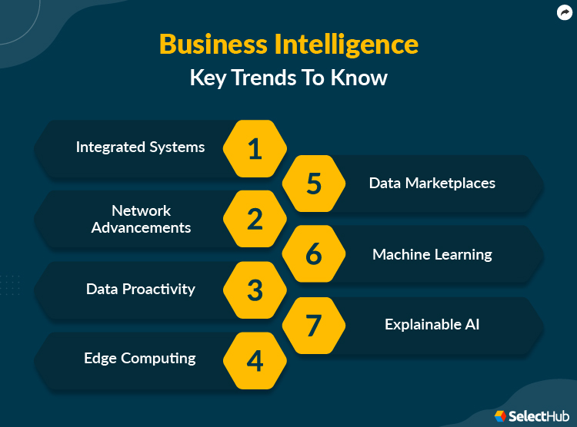
Concept and aim of Business
Intelligence

Slide 53
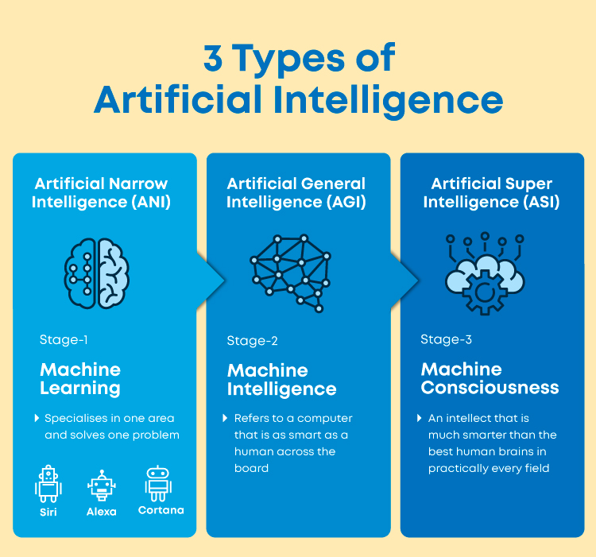
Artificial Intelligence
Artificial intelligence (AI) is concerned with the development of models that enable a computer to “think” and learn by itself through the feeding of relevant data. There are two types of AI: narrow and general. According to Hackernoon (2018), “narrow AI refers to AI which is able to handle just one particular task. General AI is something altogether more sophisticated. This refers to a system which is able to cope with any generalized task which is asked of it, much like a human.”

Slide 54
Machine learning :
Machine learning is a subset of artificial intelligence in which numerical models are developed in order to predict the probability of a future event or new data record. The prediction result is expressed in the form of a probability between 0 and 100 percent, a probability density function, or a number with associated uncertainty. Results are evaluated using predefined accuracy metrics and then transformed into a business decision using a given objective and key performance indicators.

Slide 55
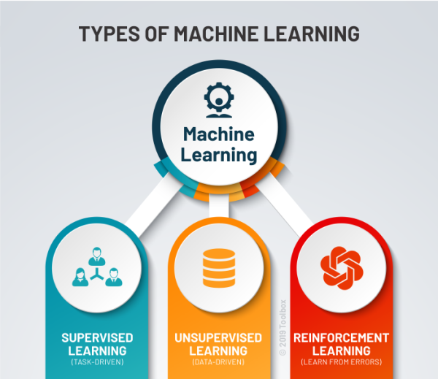
Machine learning :

Slide 56
Machine learning :
Unsupervised learning This is a blind machine learning task of inferring a binary function (on/ off) where the target output is not defined.
There is a third type of machine learning, called reinforcement learning. An objective is defined, and the computer learns the best approach to achieve this objective.

Slide 57
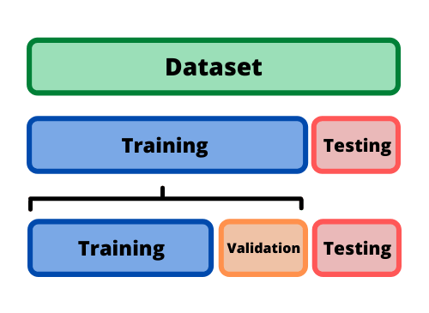
Training and testing sets
The training set is comprised of the particular records in a dataset that are used by the machine learning model to build a predictive mathematical function. The testing set is made up of different records in a dataset that are used to measure the performance of the machine learning model that has been developed.

Slide 58
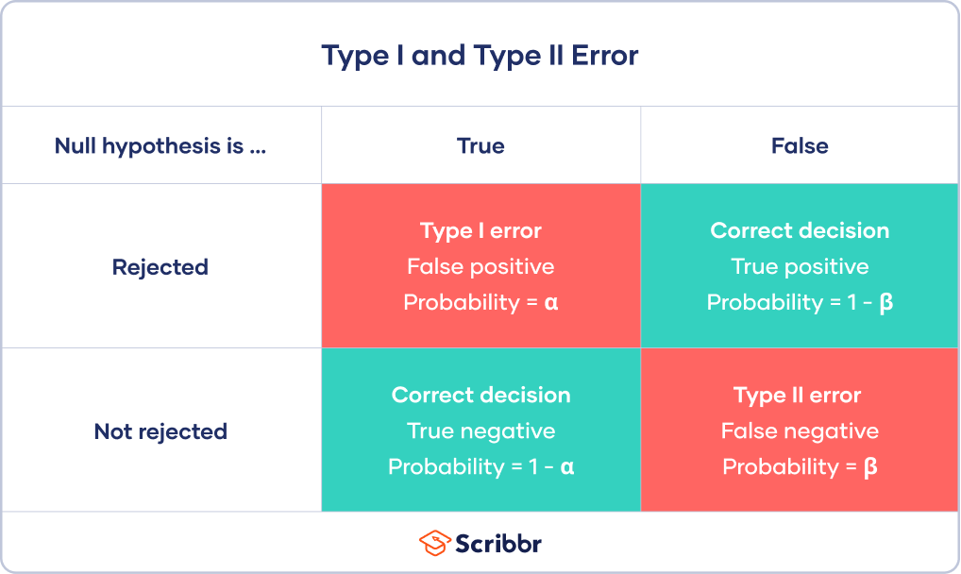
Types of errors

Slide 59
Definition and objective of Dimensionality reduction:
The process of reducing a dataset to a list of selected variables while ensuring that it conveys similar information is called dimensionality reduction. The list of selected variables excludes those variables which are redundant and/or have little influence on the changeability of the dataset. The objective of applying dimensionality reduction is to simplify the computational cost required to develop the machine learning model.

Slide 60
Explanation of sensitivity and specificity
Sensitivity and specificity represent the true positive rate and true negative rate, respectively.
sensitivity = 1 − type II error
number of real positives
specificity = 1 − type I error
number of real negatives

Slide 61
Explanation of sensitivity and specificity

Slide 62
Applications of Data Science with examples:
Industrial processes applications: Data are obtained at different levels of the production process, e.g., ingredient and actuator data at the field level; signal data at the control level; monitoring sensor data at the execution level; and indicator data at the planning level.
Business applications: Businesses can be sources of data about aspects such as customers, portfolios, human resources, marketing, sales, and pricing. The main goal of applying data science to business data is to better understand, motivate, and drive business processes. For example, bottlenecks in business processes can be identified and predictions about sales can be estimated.

Slide 63
Applications of Data Science with examples:
Text data applications: Data contained within text serve in many applications as an important information resource. Examples are text documents, e-mails, and Web documents. The main goal of applying data science to text data is to filter, search, extract, and structure information.
Image data applications: Data formatted as images are easy to obtain due to advances in imaging sensor technology. Sensors range from cameras in smartphones to satellite cameras and provide large amounts of two- and three-dimensional image data. The main goal of applying data science to image data is to find and recognize objects, analyze and classify scenes, and relate the images to other information sources.

Slide 64
Applications of Data Science with examples:
Medical data applications: Medical data are collected from patient care (e.g., patient health records), clinical care programs, and medical laboratory experiments, among others. A few of the reasons to apply data science to medical data are to analyze, understand, and annotate the influence/side effects of medicines and detect and predict different levels of certain diseases.

Slide 65
Applications of Data Science with examples:

Slide 66
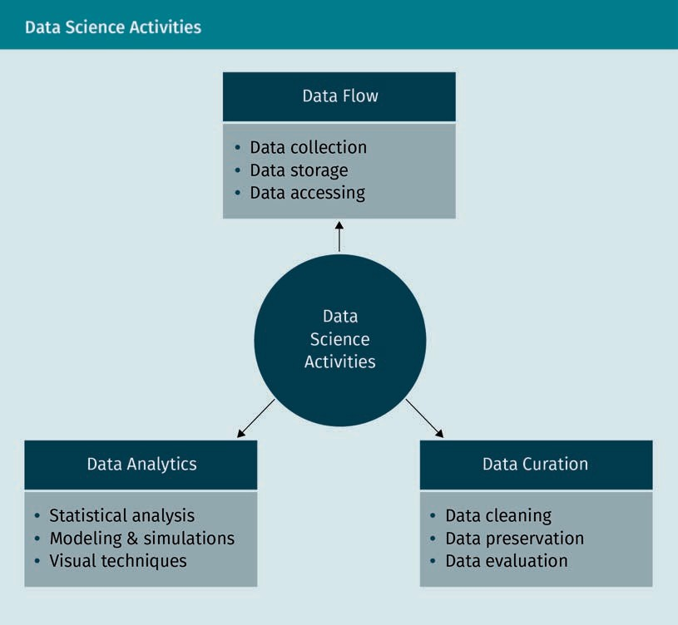
1.2 Data Science Activities
Explanation of three dimensions of Data Science with illustration

Slide 67
First Dimension: Data Flow
Managing data flow starts with the collection of data, including a list of possible sources and attributes. The storage structure of the data is designed to coincide with the format of the collected data, and the stored data must be transparent, complete (to an extent), and accessible.

Slide 68
Second Dimension: Data Curation
Data curation is the process of refining collected data, and there are different ways of doing so.
“Data preservation” means the data are cleaned from noise (e.g., typing errors in data entries) and fake outliers, and if there are missing values, one has to deter- mine how they should be handled. Improving data quality typically requires detailed knowledge of the domain in which the data are recorded.
“Data description” includes data structure, schemes, and metadata.
“Data publication” helps make data available so it can be used effectively.
“Data security” is necessary to secure and protect data, as well as determine the legal frameworks and policies to be followed. Physical threats and human errors should be identified wherever possible.

Slide 69
Third Dimension: Data Analytics
Data analytics uncovers hidden patterns in the data and transforms data into relevant, useful information. It predicts future events in order to support and/or automate decision-making processes. Analytics techniques include modeling and simulation, machine learning, artificial intelligence, and statistical analysis.

Slide 70
1.3 Sources of Data
Explanation of different sources of data
Explanation with examples of Data types- Quantitative and Qualitative
Subtypes of Quantitative data with examples
Types of Data Shapes with examples
Explanation of 5Vs of Data with examples

Slide 71
1.3 Sources of Data:
Data sources should be trustworthy to ensure the collected data are robust and high quality. Common sources of data are companies, governments, academic institutions, websites, and media platforms.
Organizational and trademarked data sources
Large companies like Google and Facebook possess enormous amounts of data. They provide bulk downloads of public data for offline analysis in order to enrich the organization’s market visibility. Google and Facebook also have internal data for use by their employees. Almost all companies possess their own data collected from internal systems that record various activities. The first and most important users of this proprietary data are the company’s employees, although some companies sell datasets (e.g., weather forecasts).

Slide 72
1.3 Sources of Data:
Government data sources
Federal governments are committed to providing open data to enable and enhance how the government fulfills its missions. Governmental organizations also release demographic and economic data (e.g., population per geographic region) every few years to be analyzed for the sake of more accurate risk estimation.
Academic data sources
Academic research creates large datasets, and many scientific journals require that these datasets be made available to other researchers. These datasets span many fields including medicine, economics, and history.

Slide 73
1.3 Sources of Data:
Web page data sources
Web pages often provide valuable numerical and textual data. For example, you can request all tweets containing a certain hash tag from Twitter (e.g., iPhone X) and apply sentiment analysis to determine whether a tweet has a positive or negative slant on that topic (i.e., hash tag). The customer support division of an organization associated with this topic (e.g., Apple) can use this information to improve their business operations.
Media data sources
Media includes videos, audios, and podcasts that provide quantitative and qualitative information on the characteristics of user interaction. Since media crosses all demo- graphical borders, it is the quickest method for businesses to identify and extract pat- terns in data to enhance decision-making.

Slide 74
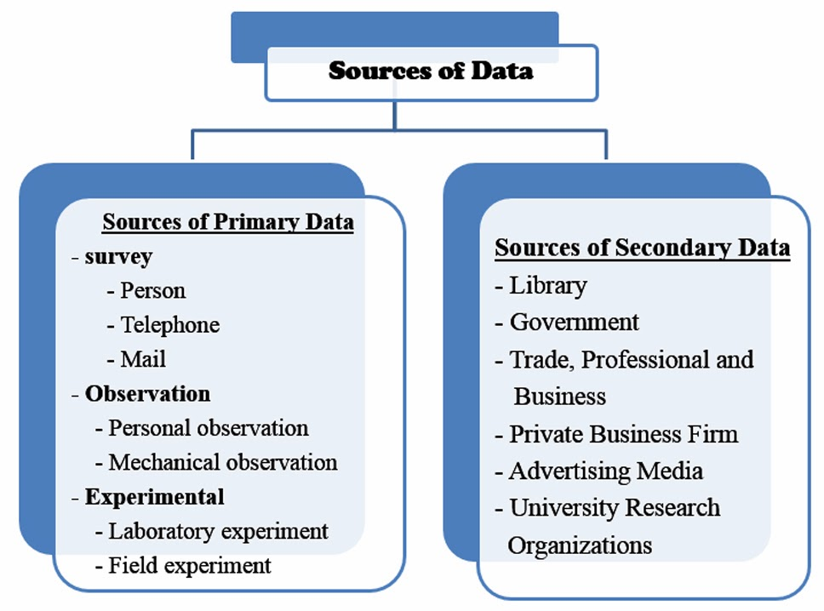
1.3 Sources of Data:

Slide 75
Explanation with examples of Data types- Quantitative and Qualitative

Slide 76
Data types- Quantitative and Qualitative:
Quantitative data: Quantitative data are measurable values. Subtypes include
categorical nominal. Categories of this subtype do not have an inherent order (e.g., eye color).
categorical ordinal. Categories of this subtype have inherent order (e.g., salary grade, age group). These data come either in ordered or unordered sequences. For exam- ple, {A, B, C} does not indicate that “A” has the highest/lowest priority because such a ranking should be according to another predefined parameter.

Slide 77
Data types- Quantitative and Qualitative:
Qualitative data
Qualitative data provide information about the quality of a good or service. Examples of qualitative data are customer feedback about a product, focus group discussions, and answers to open-ended questions.

Slide 78
Subtypes of Quantitative data with examples:
categorical binary. In this subtype, data are divided into one of two categories (e.g., gender (male/female), power button status (on/off)).
discrete. In this subtype, the data attribute is usually any digit in the numbering sys- tem (e.g., number of students, student ages).
continuous. In this subtype, a data attribute is a value within a range (e.g., tempera- ture, student exam results).

Slide 79
Subtypes of Quantitative data with examples

Slide 80
Data Shapes with examples:
Structured data These data have a high level of organization, such as information shaped in tabular forms of rows and columns.
Unstructured data These are data with unknown form or structure.
Semi-structured data These are all data shapes between structured and unstructured.

Slide 81
Types of Data Shapes with examples

Slide 82
Explanation of 5Vs of Data with examples:
Volume: The amount and scale of data is their volume.
Variety: Data come from many sources, are of many types, and have different levels of complexity.
Velocity: The speed at which data are created, stored, analyzed, and visualized is the velocity.
Veracity: Data's quality is their veracity.
Validity: This refers to the value of data in extracting useful information for making a decision.

Slide 83
Explanation of 5Vs of Data with examples

Slide 84
THANK YOU

